Slide 1
The Writing Revolution
Advancing Thinking Through writing in all Subjects & Grades

Slide 2
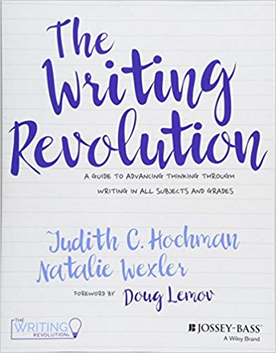
From the book:
Also:
www.thewritingrevolution.org

Slide 3
The Hochman Method strategies are used to check students’ comprehension and deepen their understanding of the content they are learning.

Slide 4
The
Strategies

Slide 5
Fragment Activities:
help students understand concept of a complete sentence and discern sentence boundaries
help students understand the meanings of subjects, predicates and prepositional phrases
encourage careful reading

Slide 6
What Makes a Sentence a Sentence? Fragments
A fragment is a group of words that is not grammatically a complete sentence. It is missing a key component of the sentence, usually lacking a subject, verb, or both. Read the following and identify each as a sentence or fragment. If you are unsure, read it aloud. Is it a complete thought? Does it sound unfinished? Does it tell the subject or who or what the sentence is about? Does it have a predicate, what the subject is or does?
_______ made observations about the rocks on the shore
_______ scientists study the world around them by making observations and drawing conclusions
_______ was bubbling and overflowed onto the table
_______ students concluded
Choose one of the fragments and turn it into a complete sentence:
____________________________________________________________________________________________________________________________________________________________________________________________

Slide 7
Examples of Sentence Stems from a Global 2 History & Geography Classroom
Early Cold War Cognition Check
The Marshall Plan was focused on ___________________________________________________
The Marshall Plan was successful because _____________________________________________
The Berlin Blockade was created by Stalin to ___________________________________________
The Truman Doctrine was initially focused on _________________________________________
The Truman Doctrine is SIMILAR to the Marshall Plan because __________________________
The Truman Doctrine is DIFFERENT than the Marshall Plan because _____________________

Slide 8
Sentence-Type Activities:
enable students to vary sentence structure
provide one way to develop and improve concluding sentences
encourage students to formulate questions

Slide 9
Write a question using the word immigrants.
Write a statement using Ellis Island.
Write an exclamation using freedom.
Write a command using citizen.

Slide 10
Developing questions:
encourages students to think about the important features in text
encourages careful reading and analytical thinking
helps students to focus on the key elements
provides practice in understanding and using expository terms
helps students anticipate what questions they may be asked

Slide 11
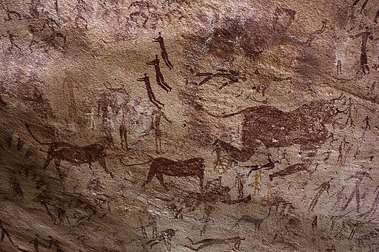
Paleolithic Age
Directions: Write two questions about the picture.
________________________________________________________________________
________________________________________________________________________

Slide 12
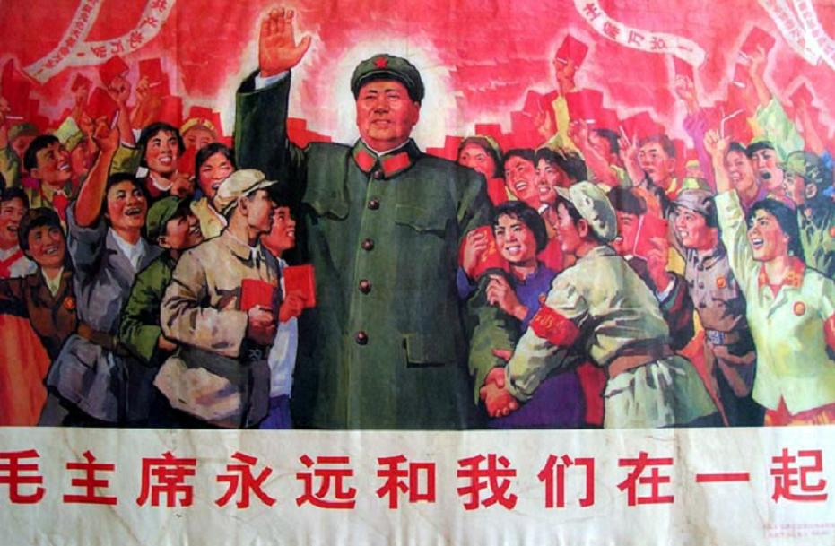
Write 2 questions based on what you see below:
___________________________________________________________________________
___________________________________________________________________________

Slide 13
Let’s Play Jeopardy!
Q. ___________________________________________________________________________________
He was determined to rescue as many animals as possible before Hurricane Florence hit.
Q. ___________________________________________________________________________________
53 dogs and 11 cats
Q. ____________________________________________________________________________________
He believes animals’ lives are important, too.
Q. _____________________________________________________________________________________
He bought a bus.
Q. _____________________________________________________________________________________
A. Tony Alsup posted on Facebook, asking people to point him to where pets needed help.

Slide 14
Conjunction Activities:
promote extended responses
encourage analytical and deeper thinking about text
foster close reading
provide practice using new vocabulary words
develop ability to craft linguistically complex sentences using written rather than oral language conventions
enhance reading comprehension by familiarizing students with more complex syntax and sentence structure

Slide 15
Conjunctions
Conjunctions include words such as and, because, and but. Using conjunctions to connect words, phrases, and clauses helps make writing clear and it sounds more sophisticated. It also provides more information to the reader.
Because explains why something is true.
But indicates a change of direction – similar to a U-turn.
So tells us what happens as a result of something else – in other words, a cause and its effect.
Let’s practice:
The apple crop has been mediocre this year because _____________________________________________.
The apple crop has been mediocre this year, but _________________________________________________.
The apple crop has been mediocre this year, so ___________________________________________________.
Abraham Lincoln was a great president because __________________________________________________.
Abraham Lincoln was a great president, but ______________________________________________________.
Abraham Lincoln was a great president, so _______________________________________________________.

Slide 16
Mao Zedong wanted to transform China because ____________________________________________.
Mao Zedong wanted to transform China but _________________________________________________.
Mao Zedong wanted to transform China so _________________________________________________.

Slide 17
Sample of student response to novel Speak:
Melinda doesn’t speak because she called the cops on the party and everyone hates her now.
Melinda doesn’t speak, but no one really sees that.
Melinda doesn’t speak, so no one knows what happened to her.

Slide 18
Subordinating Conjunctions: Conjunctions that introduce an adverb clause, and signal the relationship between that clause and the main idea. Ex. Although the book sold well, it was not very good.
Let’s practice! Complete the following sentences:
Before going to bed, _______________________________________.
After you do your homework, __________________________________.
Before you cross the street, ____________________________________.

Slide 19
Using appositives:
provides another option for writing and improving topic and concluding sentences, together with sentence types and subordinating conjunctions
enables students to vary sentence structure
allows students to include more information and adds complexity
improves reading comprehension
promotes formal written language style
encourages careful reading

Slide 20
Appositives: a phrase or clause equivalent to a noun, that is placed beside another noun to explain it more fully.
Complete the sentence with an appositive:
Write sentences that include the following appositives:
Leanora Sutter, __________________, enjoyed her job caring for an elderly, white man.
Esther Hirsh, _____________________, came to live with Sara as a “fresh air kid” from New York City.
Reynard Alexander, ________________, was hopeful that the townspeople would “come to their senses” about the Klan.
an independent woman
an impressionable young man
an outspoken clergyman

Slide 21
Insert the correct appositive into the appropriate sentence:
leader of the Nationalist Party
leader after Mao Zedong died
leader of the Communists
Mao Zedong, ___________________________, led a program called the Great Leap Forward to increase agricultural and industrial output.
Jiang Jieshi, ____________________________, took over after the death of Sun Yixian and began to strike at the Communist Party, which he saw as a threat to his leadership.
Deng Xiaoping, _________________________, brought more economic freedom to the country but little political change.

Slide 22
Sentence-combining:
teaches grammar & usage effectively
allows students to see various options for crafting complex sentences
exposes students to varied writing structures
enhances syntactic flexibility

Slide 23
Directions: Combine the three sentences into one well-written sentence that means the same thing.
Peter the Great was an absolute ruler.
Peter the Great was a complicated man.
Peter the Great modernized Russia.
Habeas Corpus was an act of democracy.
Habeas Corpus stated that an arrested person may secure a court order.
Habeas Corpus stated that an arrested person has the right to a speedy trial.
The Bill of Rights was a component of English Democracy.
Parliament needed to approve taxes.
Parliament needed to maintain the army.

Slide 24
Sentence expansion:
enables students to anticipate what a reader needs to know and to provide that information
teaches note-taking strategies (key words, symbols, abbreviations)
enables students to craft written language structures
develops the ability to summarize, prepares student to revise more effectively

Slide 25
Sentence Expansion
Directions: Expand the following sentence using the question words.
He/she is scared.
Who: ……Mrs. Harmon…………
When: ……when the police came…………………………………………….
Where: …her apartment……………………………………………………
Why: they handcuffed her son and took him away and she didn’t know where they were taking him………
Expanded Sentence:
Mrs. Harmon was scared when the police came to her apartment door and took her son away in handcuffs because she didn’t know what was going to happen to him!

Slide 26
Sentence Expansion:
Read the passage below, then expand the following sentence using the question words.
The Communists, under Mao Zedong, rose to power in China after World War II. Their appeal to peasants and to women, their superior army, and lack of support for the Nationalists led to victory for the Communists. The communist government severely restricted the rights and freedoms of most Chinese. Later leaders, such as Deng Ziaoping, allowed free market reforms but little political freedom. Violations of human rights in China have often made relations between China and the United State difficult.
Communism was complex.
** When: ………………………………………………………………………………………………………………………………………………….
Where: ……………………………………………………………………………………………………………………………………………………..
Who: ………………………………………………………………………………………………………………………………………………………..
Why: …………………………………………………………………………………………………………………………………………………………
Expand the sentence now starting with WHEN:
________________________________________________________________________________________________________________________________________________________________________________________________________

Slide 27
Planning using an outline:
enables students to visualize beginning, middle, and end of a paragraph or composition
helps them distinguish between essential and non-essential material
encourages placing information in logical order
prevents repetition
improves ability to stick with the topic
promotes analytical thinking

Slide 28
The Match Game: Which Details go with Which Topic Sentence?
T.S. George Washington, the first president of the United States, had a remarkable life.
1……………………………………………………………………………………………………………………………….
2………………………………………………………………………………………………………………………………
3……………………………………………………………………………………………………………………………...
4………………………………………………………………………………………………………………………………..
T.S. Although Abraham Lincoln came from humble beginnings, he became one of the greatest American presidents.
1……………………………………………………………………………………………………………………………………………….
2……………………………………………………………………………………………………………………………………………….
3………………………………………………………………………………………………………………………………………………………
4………………………………………………………………………………………………………………………………………………………
Log cabin/self-educated Revolutionary War Gettysburg Address Father of his country
Emancipation Proclamation Leader/Continental Congress Crossed Delaware/1776/Christmas
Civil War/preservation of the Union

Slide 29
Summarizing
boosts reading comprehension
generates concise and accurate responses to questions
maintains focus on the main idea and supporting details
helps students learn to paraphrase
enables students to synthesize information from multiple sources
allows students to analyze information
develops the ability to make generalizations
helps students recall the material they’re learning
provides a comprehension check

Slide 30
Single-Paragraph Outline
T.S. Some People say video games are bad but I disagree!
1……help manage stress…………………………………………………………..
2……improves focus + attention……………………………………………………………
3……improves eyesight …………………………………………………………...
4……helps decision-making……………………………………………………………
C.S.Do you agree with me that video games are not that bad?

Slide 31
Using transitions
shows the relationship between ideas
provides connections between sentences, paragraphs and sections
provides cues for the reader about how to react, think about the writing or process the information presented
helps the reader see the relationships between the main idea and the support presented for it
provides additional information to a reader
signals examples of textual evidence

Slide 32
Explain the steps to expand (x-5)(x+5) into quadratic form.
First,_______________________________________________________.
Second, _____________________________________________________.
Next, ________________________________________________________.
Then, _______________________________________________________.
Finally, ______________________________________________________.

